Slide 2
Operating SYSTEMS aND
Systems Programming
(CT30A3370) 6 credits
January 24, 2023
Venkata Marella
Silberschatz, Galvin Operating System Concepts – 7th Edition and Gagne ©2005

Slide 3
Operating SYSTEM STRUCTURE

Slide 4
TOPICS
■ Operating System Services
■ System Calls
■ Types of System Calls
■ System Programs
■ Operating System Design and Implementation
■ Operating System Structure
■ Virtual Machines
■ Operating System Generation
■ System Boot
Silberschatz, Galvin Operating System Concepts – 7th Edition and Gagne ©2005

Slide 5
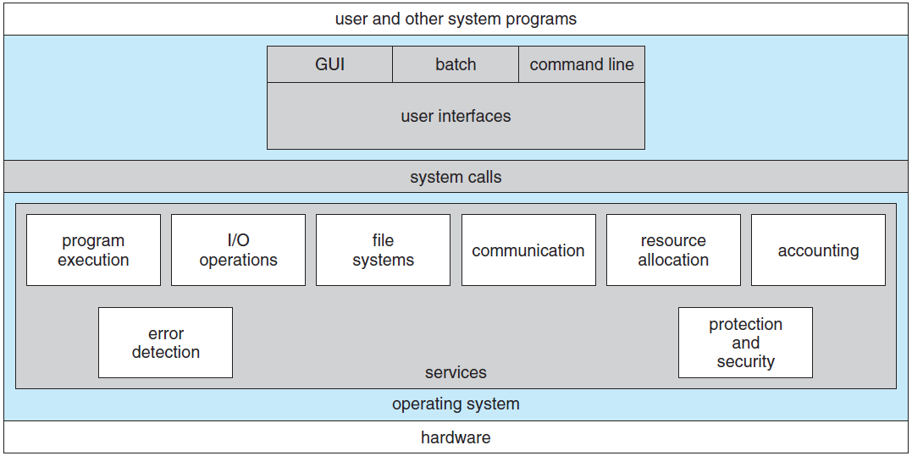
OS Structure
Silberschatz, Galvin Operating System Concepts – 7th Edition and Gagne ©2005

Slide 6
OS Services
One set of operating-system services provides functions that are helpful to the user:
  User interface - Almost all operating systems have a user interface (UI)
    Varies between Command-Line (CLI), Graphics User Interface (GUI), Batch
Program execution - The system must be able to load a program into memory and to run that program, end execution, either normally or abnormally (indicating error)
I/O operations - A running program may require I/O, which may involve a file or an I/O device.
File-system manipulation - The file system is of particular interest. Obviously, programs need to read and write files and directories, create and delete them, search them, list file Information, permission management.
Silberschatz, Galvin Operating System Concepts – 7th Edition and Gagne ©2005

Slide 7
OS Service (CONT)
Communications – Processes may exchange information, on the same computer or between computers over a network
  Communications may be via shared memory or through message passing (packets moved by the OS)
Error detection – OS needs to be constantly aware of possible errors
  May occur in the CPU and memory hardware, in I/O devices, in user program
  For each type of error, OS should take the appropriate action to ensure correct and consistent computing
  Halt system. Terminate an error-causing process or return an error code
Silberschatz, Galvin Operating System Concepts – 7th Edition and Gagne ©2005

Slide 8
OTHER OS SERViCE
Operating system functions exists not for helping the user but rather for ensuring the efficient operation of the system itself
  Resource allocation: When there are multiple users or multiple jobs running at the same time, resources must be allocated to each of them. The operating system manages many different types of resources.
  Accounting: keep track of which users use how much and what kinds of computer resources.
  Protection and security: When several separate processes execute concurrently, it should not be possible for one process to interfere with the others or with the operating system itself. Protection involves ensuring that all access to system resources is controlled.
Silberschatz, Galvin Operating System Concepts – 7th Edition and Gagne ©2005

Slide 9
System Calls
Programming interface to the services provided by the OS
Typically written in a high-level language (C or C++), Low-level language for Hardware.
Mostly accessed by programs via a high-level Application Program Interface (API) rather than direct system call use
Three most common APIs are Win32 API for Windows, POSIX API for POSIX-based systems (including virtually all versions of UNIX, Linux, and Mac OS X), and Java API for the Java virtual machine (JVM)
Why use APIs rather than system calls?
We’ll see.
Silberschatz, Galvin Operating System Concepts – 7th Edition and Gagne ©2005
Notes:
Before we discuss how an operating system makes system calls available, let’s first use an example to illustrate how system calls are used: writing a
simple program to read data from one file and copy them to another file. The first input that the program will need is the names of the two files: the input file
and the output file. These names can be specified in many ways, depending on the operating-system design.

Slide 10
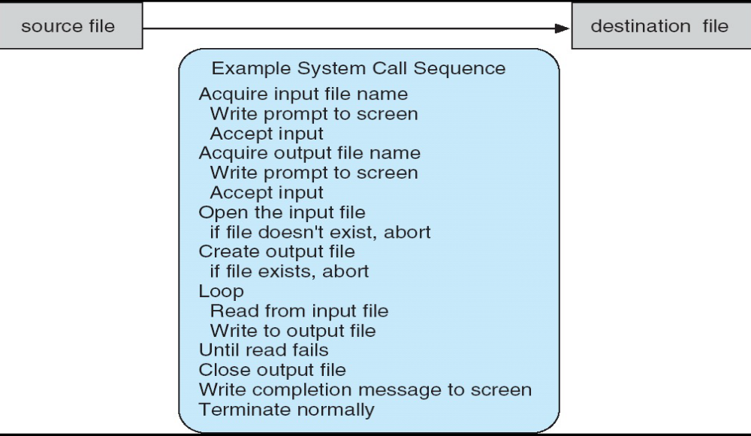
Example of System Calls
System call sequence to copy the contents of one file to another file
Silberschatz, Galvin Operating System Concepts – 7th Edition and Gagne ©2005

Slide 11
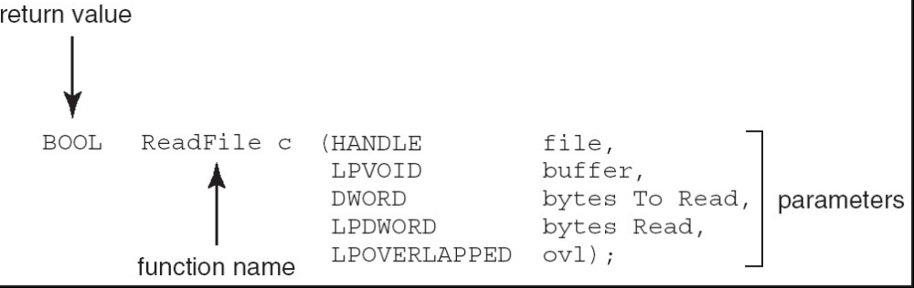
Example of Standard API
Consider the ReadFile() function in the Win32 API—a function for reading from a file
A description of the parameters passed to ReadFile()
● HANDLE file—the file to be read
● LPVOID buffer—a buffer where the data will be read into and written from
● DWORD bytesToRead—the number of bytes to be read into the buffer
● LPDWORD bytesRead—the number of bytes read during the last read
● LPOVERLAPPED ovl—indicates if overlapped I/O is being used
Silberschatz, Galvin Operating System Concepts – 7th Edition and Gagne ©2005

Slide 12
System Call Implementation
Typically, a number associated with each system call
  System-call interface maintains a table indexed according to these numbers
The system call interface invokes intended system call in OS kernel and returns status of the system call and any return values
The caller needs to know nothing about how the system call is implemented
  Just needs to obey API and understand what OS will do as a result call
  Most details of OS interface hidden from programmer by API
    Managed by run-time support library (set of functions built into libraries included with compiler)
Silberschatz, Galvin Operating System Concepts – 7th Edition and Gagne ©2005
Notes:
The system-call interface intercepts function calls in the API
and invokes the necessary system calls within the operating system

Slide 13
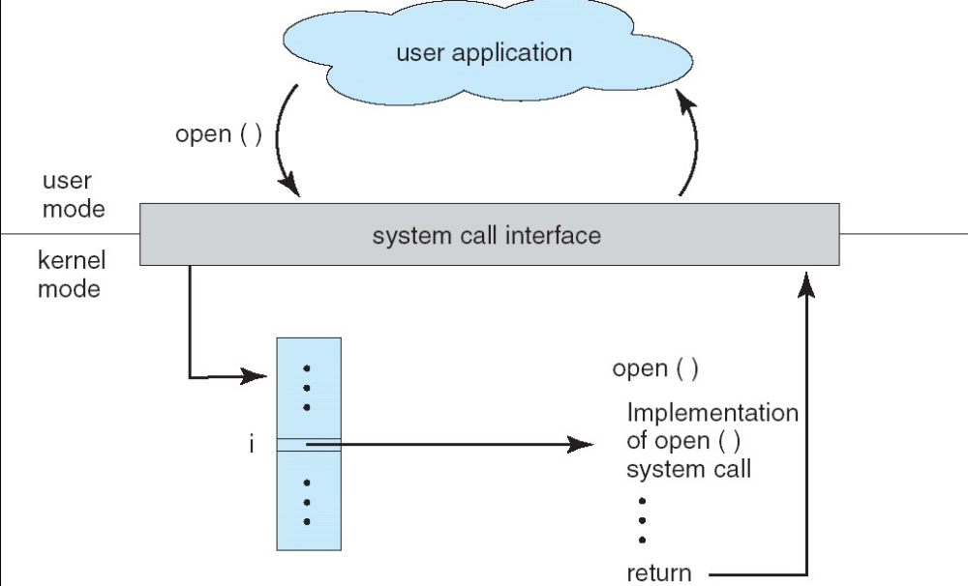
API – System Call – OS Relationship
Silberschatz, Galvin Operating System Concepts – 7th Edition and Gagne ©2005

Slide 14
System Call Parameter Passing
Often, more information is required than simply identity of desired system call
  Exact type and amount of information vary according to OS and call
Three general methods used to pass parameters to the OS
  Simplest: pass the parameters in registers
    In some cases, may be more parameters than registers
  Parameters stored in a block, or table, in memory, and address of block passed as a parameter in a register
    This approach taken by Linux and Solaris
  Parameters placed, or pushed, onto the stack by the program and popped off the stack by the operating system
  Block and stack methods do not limit the number or length of parameters being passed
Silberschatz, Galvin Operating System Concepts – 7th Edition and Gagne ©2005

Slide 15
Types of System Calls
Process control
File management
Device management
Information maintenance (e.g. time, date)
Communications
Protection
Silberschatz, Galvin Operating System Concepts – 7th Edition and Gagne ©2005
Notes:
A running program needs to be able to halt its execution either normally (end()) or abnormally (abort()).
If a system call is made to terminate the currently running program abnormally, or if the program runs into a problem
and causes an error trap, a dump of memory is sometimes taken and an error message generated.

Slide 16
PROCESS CONTROL
A running program needs to be able to halt its execution either normally (end()) or abnormally (abort()).
If a system call is made to terminate the currently running program abnormally, or if the program runs into a problem and causes an error trap, a dump of memory is sometimes taken and an error message generated.
In an interactive system, the command interpreter simply continues with the next command; it is assumed that the user will issue an appropriate command to respond to any error.
In a GUI system, a pop-up window might alert the user to the error and ask for guidance.
In a batch system, the command interpreter usually terminates the entire job and continues with the next job.
Silberschatz, Galvin Operating System Concepts – 7th Edition and Gagne ©2005

Slide 17
PROCESS CONTROL SYSTEM CALLS
End, Abort
Load, Execute
Create process, terminate process
Get process attributes, set process attributes
Wait for time
Wait event, signal event
Allocate and free memory
Silberschatz, Galvin Operating System Concepts – 7th Edition and Gagne ©2005

Slide 18
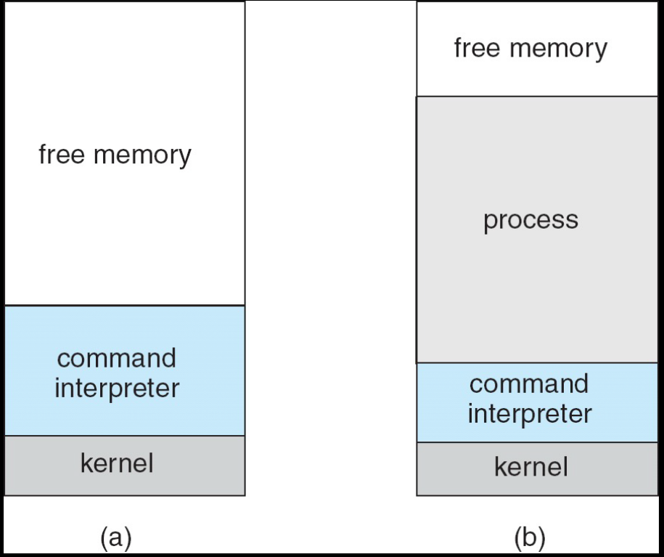
Example of process control: MS-DOS execution
Silberschatz, Galvin Operating System Concepts – 7th Edition and Gagne ©2005
a) At system startup (b) running a program, overwriting the OS itself

Slide 19
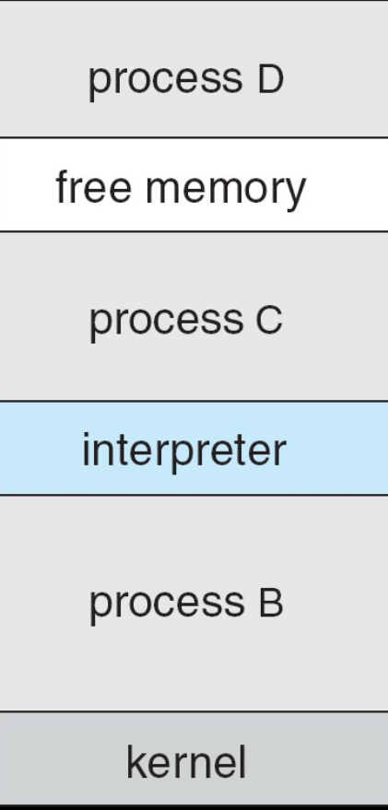
FreeBSD Running Multiple Programs
Silberschatz, Galvin Operating System Concepts – 7th Edition and Gagne ©2005

Slide 20
FILE MANAGEMENT
File management System Calls
  create file, delete file
  open, close
  read, write, reposition
  get file attributes, set file attributes
Silberschatz, Galvin Operating System Concepts – 7th Edition and Gagne ©2005

Slide 21
DEVICE MANAGEMENT
A process may need several resources to execute—main memory, disk drives, access to files, and so on
If the resources are available, they can be granted, and control can be returned to the user process. Otherwise, the process will have to wait until sufficient resources are available.
A system with multiple users may require us to first request() a device, to ensure exclusive use of it. After we are finished with the device, we release() it.
Silberschatz, Galvin Operating System Concepts – 7th Edition and Gagne ©2005

Slide 22
Information maintenance
The purpose of transferring information between the user program and the operating system.
Most systems have a system call to return the current time() and date().
Many systems provide system calls to dump() memory for debugging
Silberschatz, Galvin Operating System Concepts – 7th Edition and Gagne ©2005

Slide 23
Communication
Two common models of interprocess communication:
  Message passing model
  Shared-memory model
In the message-passing model, the communicating processes exchange messages with one another to transfer information.
In the shared-memory model, processes use shared memory create() and shared memory attach() system calls to create and gain access to regions of memory owned by other processes.
Operating system tries to prevent one process from accessing another process’s memory.
Shared memory requires that two or more processes agree to remove this restriction.
Silberschatz, Galvin Operating System Concepts – 7th Edition and Gagne ©2005

Slide 24
PROTECTION
Protection provides a mechanism for controlling access to the resources provided by a computer system
Historically, protection was a concern only on multiprogrammed computer systems with several users.
However, with the advent of networking and the Internet, all computer systems, from servers to mobile handheld devices, must be concerned with protection.
System calls providing protection include set permission() and get permission(), which manipulate the permission settings of resources such as files and disks.
The allow user() and deny user() system calls specify whether particular users can—or cannot—be allowed access to certain resources.
Silberschatz, Galvin Operating System Concepts – 7th Edition and Gagne ©2005

Slide 25
SYSTEM PROGRAM
System programs provide a convenient environment for program development and execution. They can be divided into:
  File manipulation
  Status information
  File modification
  Communications
  Application programs
  Programming language support
  Program loading and execution
Most users’ view of the operating system is defined by system programs, not the actual system
Silberschatz, Galvin Operating System Concepts – 7th Edition and Gagne ©2005
Notes:
The allow user() and deny user() system calls specify whether particular users can—or cannot—be allowed access to certain resources.

Slide 26
System programs
Provide a convenient environment for program development and execution
  Some of them are simply user interfaces to system calls; others are considerably more complex
File management - Create, delete, copy, rename, print, dump, list, and generally manipulate files and directories
Status information
  Some ask the system for info - date, time, amount of available memory, disk space, number of users
  Others provide detailed performance, logging, and debugging information
  Typically, these programs format and print the output to the terminal or other output devices
  Some systems implement a registry - used to store and retrieve configuration information
Silberschatz, Galvin Operating System Concepts – 7th Edition and Gagne ©2005

Slide 27
System Programs (cont’d)
File modification
  Text editors to create and modify files
  Special commands to search contents of files or perform transformations of the text
Programming-language support - Compilers, assemblers, debuggers and interpreters sometimes provided
Program loading and execution- Absolute loaders, relocatable loaders, linkage editors, and overlay-loaders, debugging systems for higher-level and machine language
Communications - Provide the mechanism for creating virtual connections among processes, users, and computer systems
  Allow users to send messages to one another’s screens, browse web pages, send electronic-mail messages, log in remotely, transfer files from one machine to another
Silberschatz, Galvin Operating System Concepts – 7th Edition and Gagne ©2005

Slide 28
Operating System Design and Implementation
Design and Implementation of OS not “solvable”, but some approaches have proven successful
Internal structure of different Operating Systems can vary widely
Start by defining goals and specifications
Affected by choice of hardware, type of system
User goals and System goals
  User goals – operating system should be convenient to use, easy to learn, reliable, safe, and fast
  System goals – operating system should be easy to design, implement, and maintain, as well as flexible, reliable, error-free, and efficient
Successful design: Windows 95, Windows XP, OSX
Failed design: Windows vista, Windows 8, Android 1.x
Silberschatz, Galvin Operating System Concepts – 7th Edition and Gagne ©2005

Slide 29
Operating System Design and Implementation
Important principle to separate (2.6.2)
  Policy: What will be done?
  Mechanism: How to do it?
Example: timer for CPU protection is a mechanism
Mechanisms determine how to do something, policies decide what will be done
  The separation of policy from mechanism is a very important principle, it allows maximum flexibility if policy decisions are to be changed later
Silberschatz, Galvin Operating System Concepts – 7th Edition and Gagne ©2005
Notes:
Mechanisms determine how to do something;
Policies determine what will be done.

Slide 30
Example: Separation of Mechanism and Policy
An example of mechanism/policy separation is the use of card-keys to gain access to locked doors.
The mechanisms (magnetic card readers, remote controlled locks, connections to a security server)
The entrance policy (which people should be allowed to enter which doors, at which times).
These decisions are made by a centralized security server, which (in turn) probably makes its decisions by consulting a database of room access rules.
Silberschatz, Galvin Operating System Concepts – 7th Edition and Gagne ©2005

Slide 31
Additional readings: The early principles of X
Do not add new functionality unless an implementor cannot complete a real application without it.
It is as important to decide what a system is not as to decide what it is. Do not serve all the world's needs; rather, make the system extensible so that additional needs can be met in an upwardly compatible fashion. (windows 8)
The only thing worse than generalizing from one example is generalizing from no examples at all.
If a problem is not completely understood, it is probably best to provide no solution at all.
If you can get 90 percent of the desired effect for 10 percent of the work, use the simpler solution.
Isolate complexity as much as possible.
Provide mechanism rather than policy. In particular, place user interface policy in the clients' hands.
Silberschatz, Galvin Operating System Concepts – 7th Edition and Gagne ©2005

Slide 32
Os Structure – SIMPLE STRUCTURE
MS-DOS – written to provide the most functionality in the least space
  Not divided into modules
  Although MS-DOS has some structure, its interfaces and levels of functionality are not well separated
Silberschatz, Galvin Operating System Concepts – 7th Edition and Gagne ©2005

Slide 33
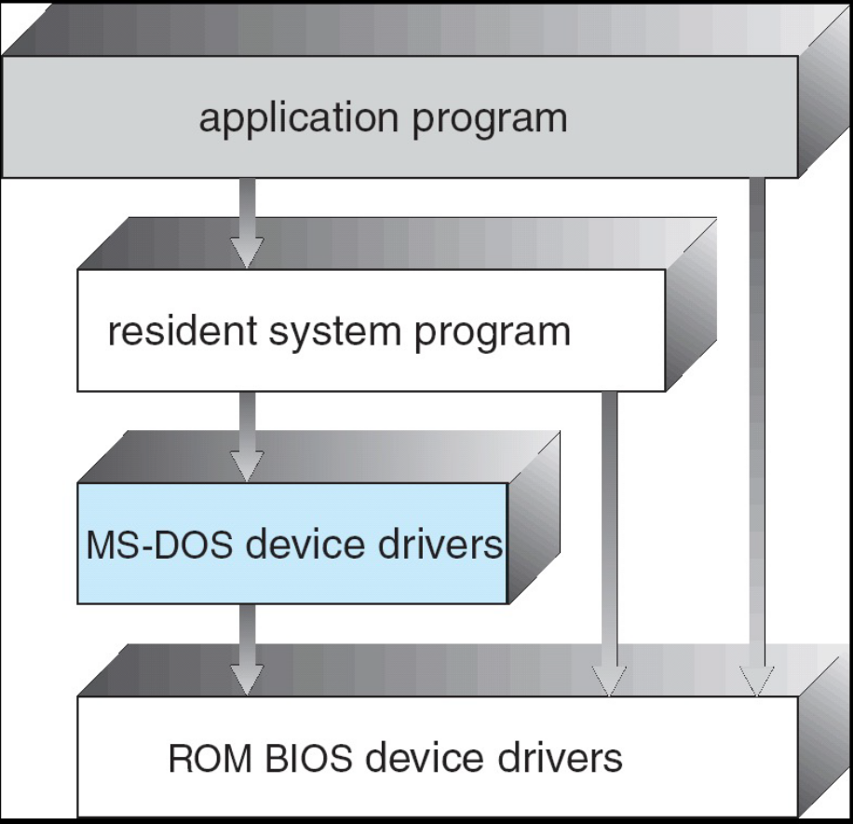
MS-DOS Layer Structure
Silberschatz, Galvin Operating System Concepts – 7th Edition and Gagne ©2005
Notes:
For instance, application programs are able to access the basic I/O routines
to write directly to the display and disk drives. Such freedom leaves MS-DOS
vulnerable to errant (or malicious) programs, causing entire system crashes
when user programs fail.
A system can be made modular in many ways. One method is the layered
approach, in which the operating system is broken into a number of layers
(levels). The bottom layer (layer 0) is the hardware; the highest (layer N) is the
user interface.

Slide 34
Layered Approach
The operating system is divided into a number of layers (levels), each built on top of lower layers. The bottom layer (layer 0), is the hardware; the highest (layer N) is the user interface.
With modularity, layers are selected such that each uses functions (operations) and services of only lower-level layers
The main advantage of the layered approach is simplicity of construction and debugging.
Silberschatz, Galvin Operating System Concepts – 7th Edition and Gagne ©2005

Slide 35
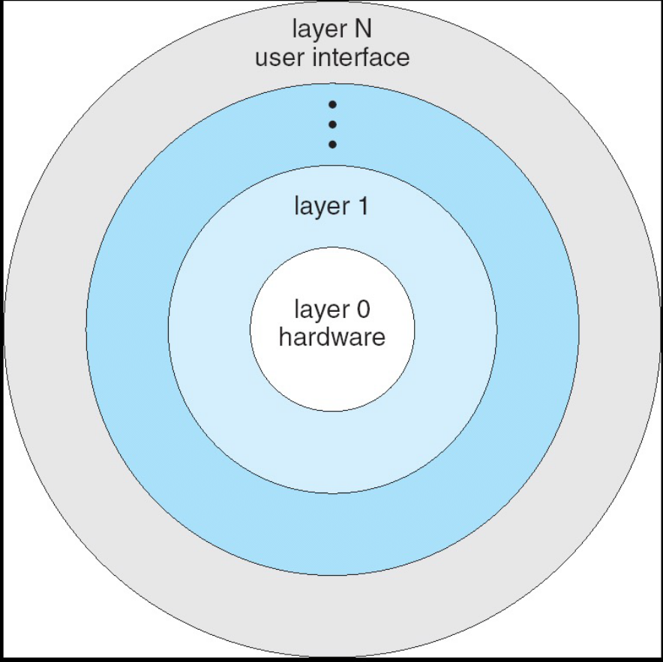
Layered Operating System
Silberschatz, Galvin Operating System Concepts – 7th Edition and Gagne ©2005

Slide 36
UNIX
UNIX – limited by hardware functionality, the original UNIX operating system had limited structuring. The UNIX OS consists of two separable parts
  System programs
  The kernel
    Consists of everything below the system-call interface and above the physical hardware
    Provides the file system, CPU scheduling, memory management, and other operating-system functions; a large number of functions for one level
Silberschatz, Galvin Operating System Concepts – 7th Edition and Gagne ©2005

Slide 37
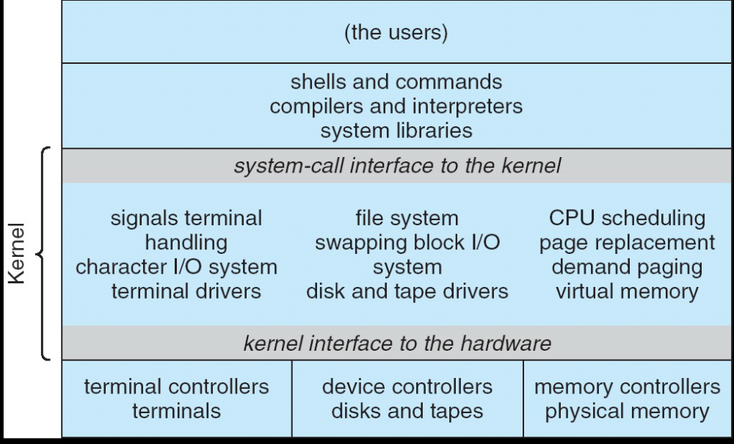
UNIX System Structure
Silberschatz, Galvin Operating System Concepts – 7th Edition and Gagne ©2005

Slide 38
Microkernel SYSTEM Architecture
Moves as much from the kernel into “user” space
Communication takes place between user modules using message passing
Benefits:
  Easier to extend a microkernel
  Easier to port the operating system to new architectures
  More reliable (less code is running in kernel mode)
  More secure
Detriments:
  Performance overhead of user space to kernel space communication
Silberschatz, Galvin Operating System Concepts – 7th Edition and Gagne ©2005

Slide 39
Modules
Most modern operating systems implement kernel modules
  Uses object-oriented approach
  Each core component is separate
  Each talks to the others over known interfaces
  Modules call each other instead of message passing
  Each is loadable as needed within the kernel
Overall, similar to layers but more flexible
Silberschatz, Galvin Operating System Concepts – 7th Edition and Gagne ©2005
Notes:
the kernel has a set of core components and links in additional services via modules, either at boot time or during run time.
This type of design is common in modern implementations of UNIX, such as Solaris, Linux, and Mac OS X, as well as Windows.
The idea of the design is for the kernel to provide core services while
other services are implemented dynamically, as the kernel is running. Linking
services dynamically is preferable to adding new features directly to the kernel,
which would require recompiling the kernel every time a change was made.
Thus, for example, we might build CPU scheduling and memory management

Slide 40
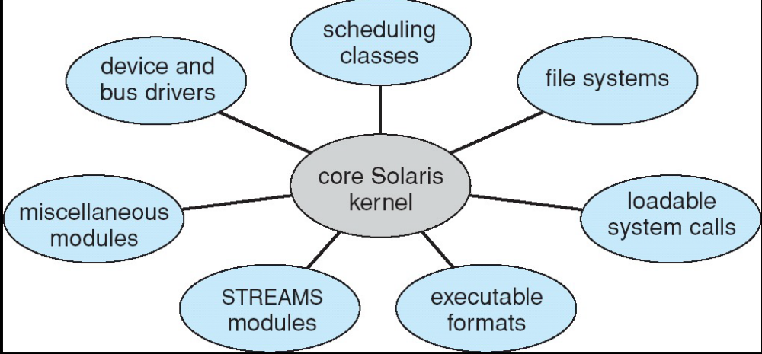
Solaris module approach
Silberschatz, Galvin Operating System Concepts – 7th Edition and Gagne ©2005

Slide 41
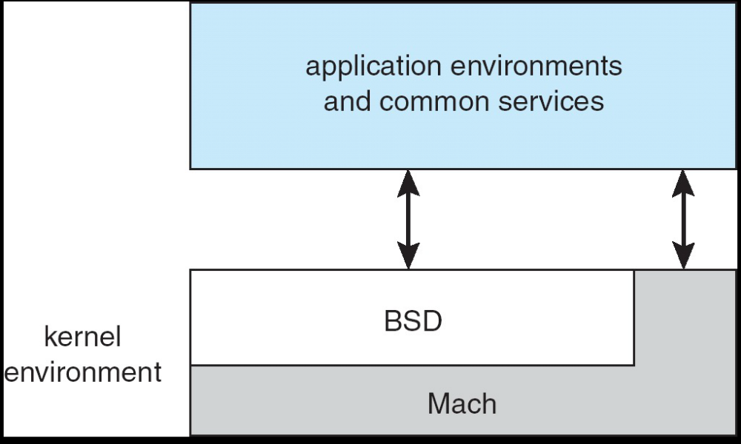
Mac OS X Structure
A hybrid structure!
Silberschatz, Galvin Operating System Concepts – 7th Edition and Gagne ©2005
Notes:
Hybrid structure
In the mid-1980s, researchers at Carnegie Mellon
University developed an operating system called Mach that modularized
the kernel using the microkernel approach.
This method structures the
operating system by removing all nonessential components from the kernel and
implementing them as system and user-level programs. The result is a smaller
kernel. There is little consensus regarding which services should remain in the
kernel and which should be implemented in user space.
Mach provides memory management;
support for remote procedure calls (RPCs) and interprocess communication
(IPC) facilities, including message passing; and thread scheduling.

Slide 42
Virtual Machines
A virtual machine takes the layered approach to its logical conclusion. It treats hardware and the operating system kernel as though they were all hardware
A virtual machine provides an interface identical to the underlying bare hardware
The operating system creates the illusion of multiple processes, each executing on its own processor with its own (virtual) memory
Silberschatz, Galvin Operating System Concepts – 7th Edition and Gagne ©2005

Slide 43
VIRTUAL MACHINES (CONTD)
The resources of the physical computer are shared to create the virtual machines
  CPU scheduling can create the appearance that users have their own processor
  Spooling and a file system can provide virtual card readers and virtual line printers
  A normal user time-sharing terminal serves as the virtual machine operator’s console
Silberschatz, Galvin Operating System Concepts – 7th Edition and Gagne ©2005

Slide 44
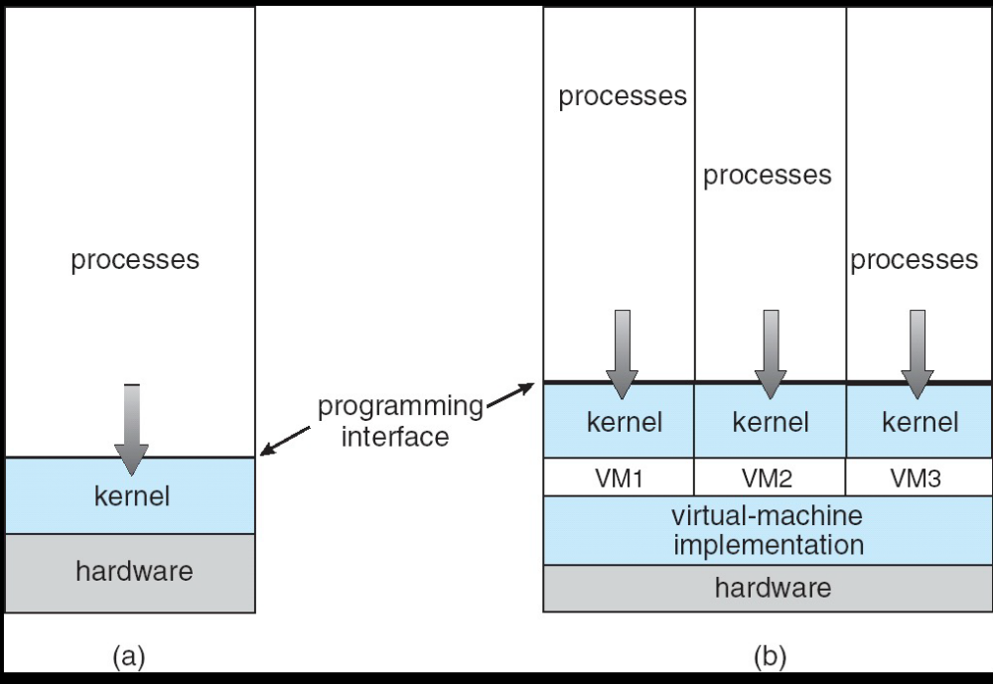
VIRTUAL MACHINES (CONTD)
Silberschatz, Galvin Operating System Concepts – 7th Edition and Gagne ©2005
(a) Nonvirtual Machine (b) virtual machine

Slide 45
Virtual Machines (Cont.)
The virtual-machine concept provides complete protection of system resources since each virtual machine is isolated from all other virtual machines. This isolation, however, permits no direct sharing of resources.
A virtual-machine system is a perfect vehicle for operating systems research and development. System development is done on the virtual machine, instead of on a physical machine and so does not disrupt normal system operation.
The virtual machine concept is difficult to implement due to the effort required to provide an exact duplicate to the underlying machine. (for example, virtual user mode and kernel mode)
Silberschatz, Galvin Operating System Concepts – 7th Edition and Gagne ©2005

Slide 46
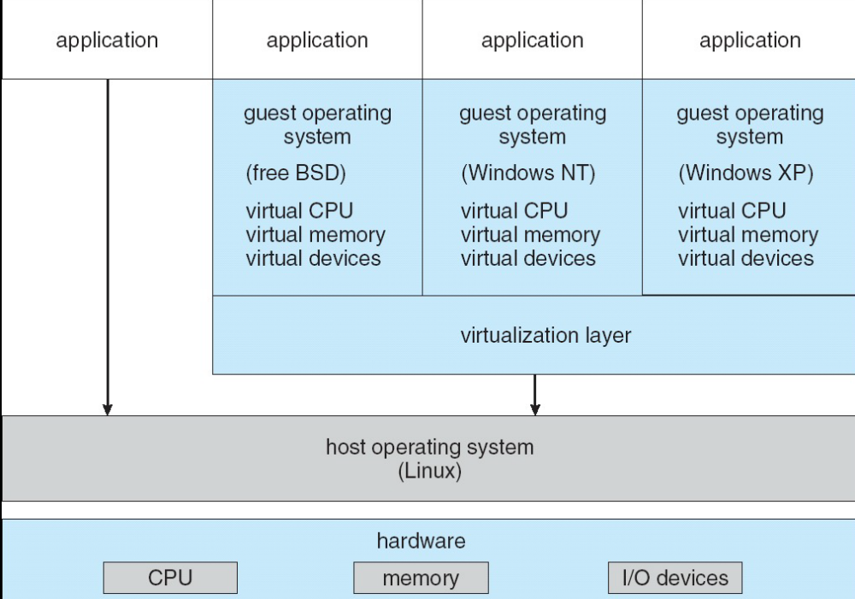
VMware Architecture
Silberschatz, Galvin Operating System Concepts – 7th Edition and Gagne ©2005

Slide 47
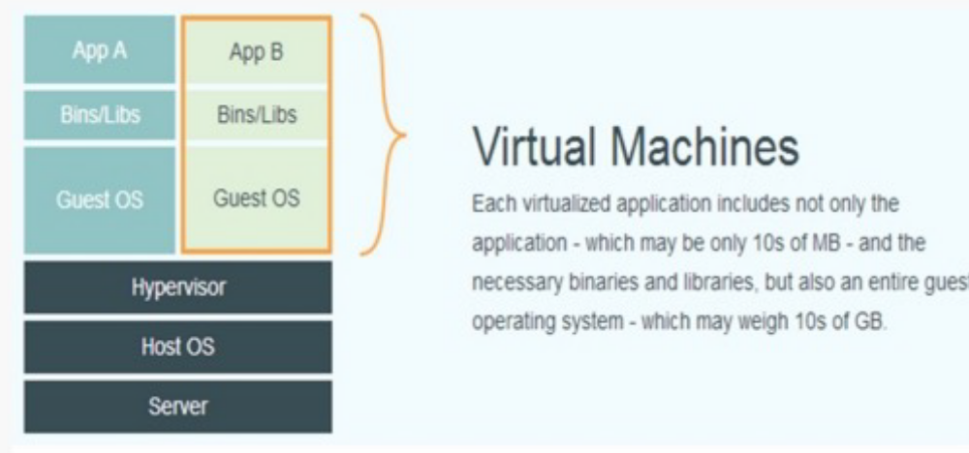
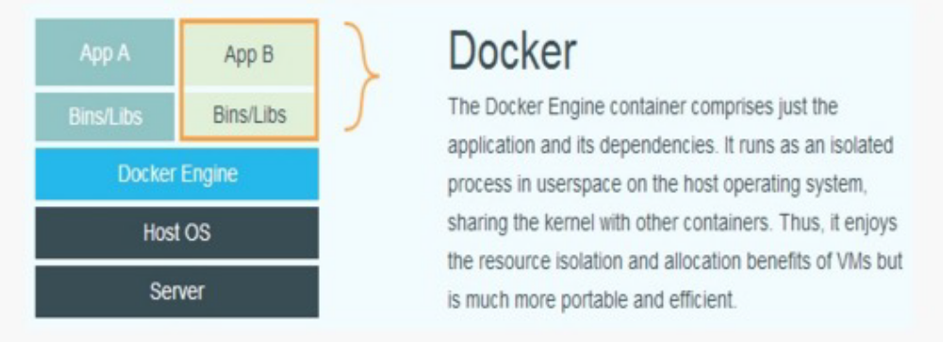
VM vs Docker
Silberschatz, Galvin Operating System Concepts – 7th Edition and Gagne ©2005

Slide 48
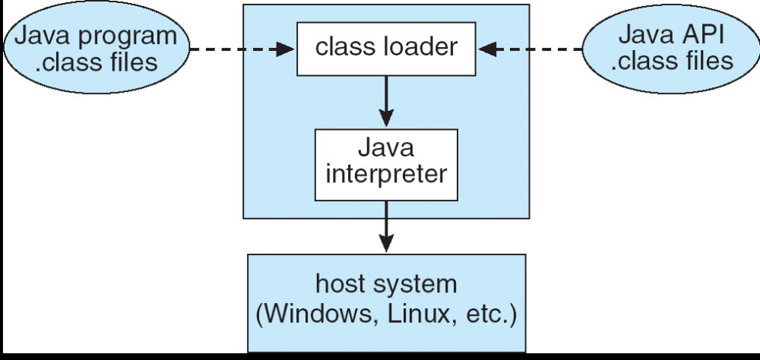
The Java Virtual Machine
Silberschatz, Galvin Operating System Concepts – 7th Edition and Gagne ©2005

Slide 49
Operating System Generation
Operating systems are designed to run on any of a class of machines; the system must be configured for each specific computer site
SYSGEN program obtains information concerning the specific configuration of the hardware system
Booting – starting a computer by loading the kernel
Bootstrap program – code stored in ROM that is able to locate the kernel, load it into memory, and start its execution
Silberschatz, Galvin Operating System Concepts – 7th Edition and Gagne ©2005

Slide 50
System Boot
Operating system must be made available to hardware so hardware can start it
Small piece of code – bootstrap program (a.k.a. bootstrap loader), locates the kernel, loads it into memory, and starts it
Sometimes two-step process where boot block at fixed location loads bootstrap loader
When power initialized on system, execution starts at a fixed memory location
  Firmware used to hold initial boot code
Silberschatz, Galvin Operating System Concepts – 7th Edition and Gagne ©2005

