Slide 1


CT60A2411
Single dimensional arrays : Week 3B
Ashok Kumar Veerasamy, PhD

Slide 2

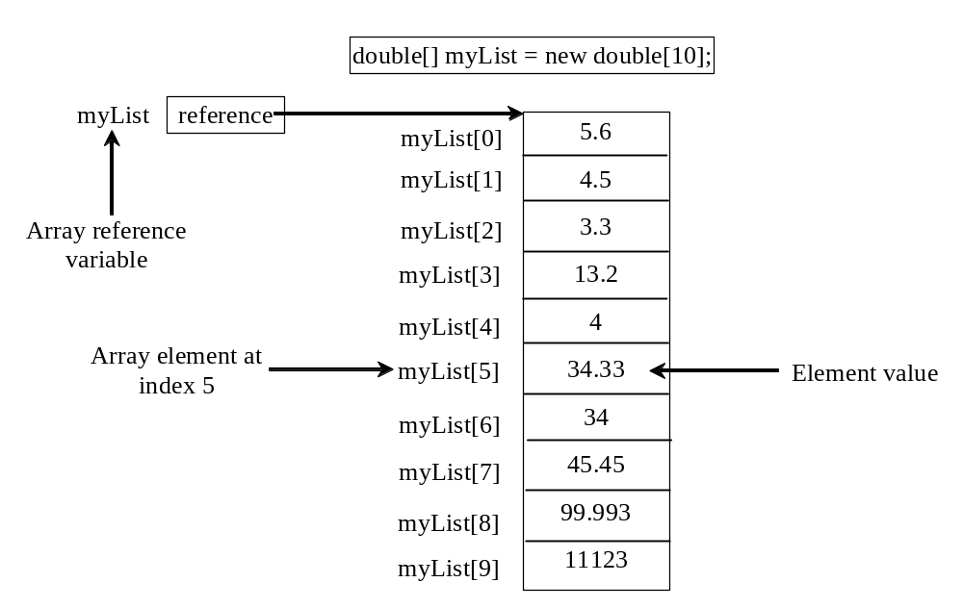
Arrays
Array is a data structure that represents a collection of the same data type data.

Slide 3
Declaring and creating Arrays
datatype[] arrayName = new datatype[arraySize];
double[] myArray = new double[10];
Once an array is created, its size is fixed. It cannot be changed. You can find its size using arrayName.length
    System.out.println(myArray.length); // returns 10
Declaring, creating, initializing in one step:
double[] myPoints = {1.9, 2.9, 3.4, 3.5};
This shorthand syntax must be in one statement.

Slide 4
Arrays : Example program
public static void main(String[] args) {
Scanner input = new Scanner(System.in);
int myArray[] = new int[5]; // can have 5 integer values
for (int i = 0; i<5; i++) { // loop to get input for 5 times
myArray[i]=input.nextInt();
}
for (int j = 0; j<5; j++) { // loop to iterate into array index
System.out.print(myArray[j]+" ");
}
}
double[] myPoints = new double[4];
myPoints[0] = 1.9;
myPoints[1] = 2.9;
myPoints[2] = 3.4;
myPoints[3] = 3.5;
The shorthand notation of aforenoted statements
double[] myPoints = {1.9, 2.9, 3.4, 3.5};

Slide 5
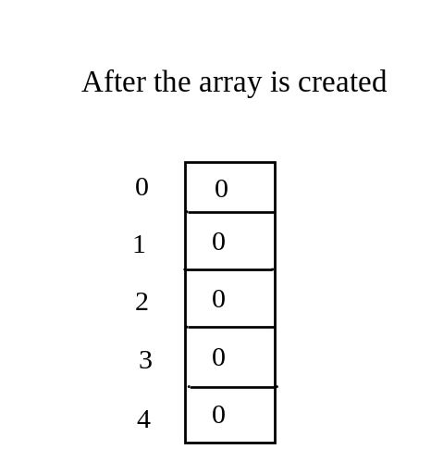
What will be the output of the programs given below?
public class Test {
public static void main(String[] args) {
int[] values = new int[5];
for (int i = 1; i < 5; i++) {
values[i] = i + values[i-1];
}
values[0] = values[1] + values[4];
}
}
public class array2W3 {
public static void main(String[] args) {
boolean[] Array1 = {true, false, true, true, false};
for (int i = 0; i<Array1.length;i++) {
if(Array1[i]) {
System.out.println(Array1[i]);
}
}
}
}

Slide 6
Copying arrays
public static void main(String[] args) {
double[] myArray1 = {1.9, 2.9, 3.4, 3.5};
double[] myArray2 = myArray1; // copying values of myArray1 ?
myArray2[1] = 50.5; //Modifying index [1]’s value of myArray2
System.out.println(myArray1[1]); // will return 50.5 why?
}
Myarray1
Contents of Myarray1
myArray2 = Myarray1;
Myarray2
So, how to make duplicate of an array or have two different arrays to copy values from one array to another?
Refer the next slide

Slide 7
public static void main(String[] args) {
double[] myArray1 = {1.9, 2.9, 3.4, 3.5};
double[] myArray2 = new double[myArray1.length];
for (int i = 0; i < myArray1.length; i++) {//use loop to copy values
myArray2[i] = myArray1[i];
}
myArray2[1] = 50.5;
System.out.println(myArray1[1]);// return 2.9
System.out.println(myArray2[1]);// return 50.5
}
public static void main(String[] args) {
double[] myArray1 = {1.9, 2.9, 3.4, 3.5};
double[] myArray2 = new double[myArray1.length];
System.arraycopy(myArray1,0,myArray2,0,myArray1.length);
for (int i = 0; i<myArray2.length;i++) {
System.out.println(myArray2[i]);
}
myArray2[1] = 50.5;
System.out.println(myArray1[1]);// returns 2.9
System.out.println(myArray2[1]);// returns 50.5
}

Slide 8
What will be the output of the program below?
public class arrayCopy3W3 {
public static void main(String[] args) {
double[] xArray = {1.9, 2.9, 3.4, 3.5};
double[] yArray = new double [10];
double[] zArray = new double[10];
System.arraycopy(xArray,0,yArray,0,xArray.length);
System.arraycopy(xArray,0,zArray,5,3);
//printing yArray values
for (int i = 0; i<yArray.length;i++) {
System.out.println(yArray[i]);
}
System.out.printf("........................\n");
//printing zArray values
for (int i = 0; i<zArray.length;i++) {
System.out.println(zArray[i]);
}
}
}

Slide 9
The program given below has run time error. Fix it.
public class arrayCopy4W3 {
public static void main(String[] args) {
char[] letterArray = {'x','2','a','B','d','8','#’};
char[] copyArray = new char[5];
System.arraycopy(letterArray,0,copyArray,0,letterArray.length);
//printing copyArray values
for (int i = 0; i<copyArray.length;i++) {
System.out.println(copyArray[i]);
}
}
}

Slide 10
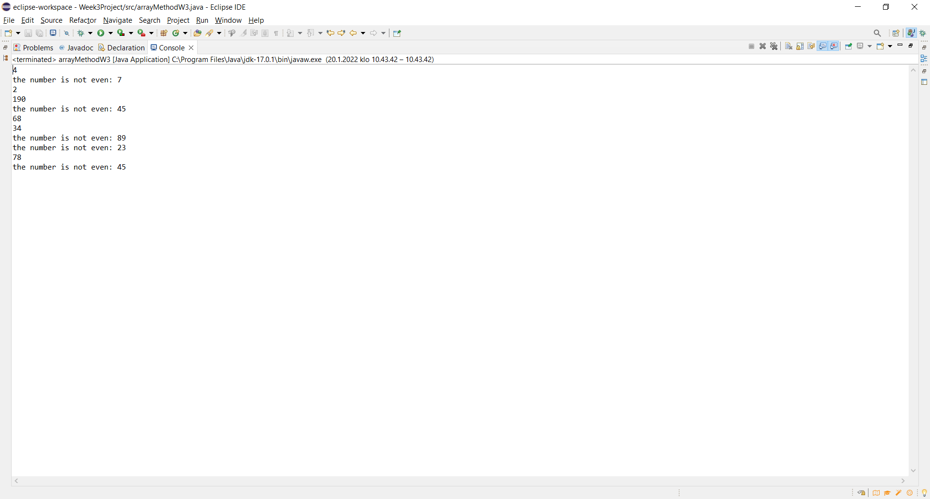
Passing arrays to Method
public class arrayMethodW3 {
public static void printEven(int[] array) {
for (int i = 0; i<array.length;i++) {
if(array[i]%2==0) {
System.out.println(array[i]);
}
else {
System.out.println("the number is not even: "+array[i]);
}
}
}
public static void main(String[] args) {
int[] numbers = {4,7,2,190,45,68,34,89,23,78,45};
printEven(numbers);
}
}

Slide 11
What will be the output of the program below?
public class arrayMethod2W3 {
public static void main(String[] args) {
int x = 1; // x represents an int value
int[]y = new int[10]; // y represents an array of int values
m(x, y); // Invoke m with arguments x and y
System.out.println("x is " + x);
System.out.println("y[0] is " + y[0]);
}
public static void m(int number, int[] numbers) {
number = 1001; // Assign a new value to number
numbers[0] = 5555; // Assign a new value to numbers[0]
}
}

